Slide 1
Chapter 2
Internet of Things, Preliminaries and Foundations

Slide 2

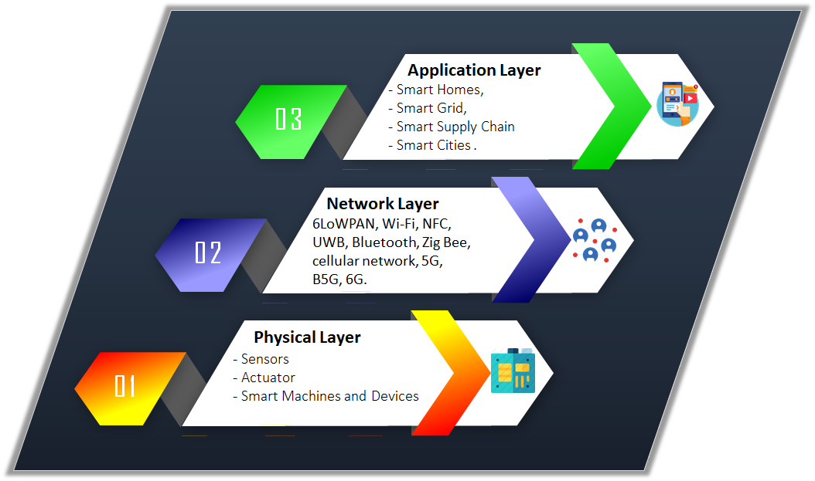
The Architecture of IoT system

Slide 3
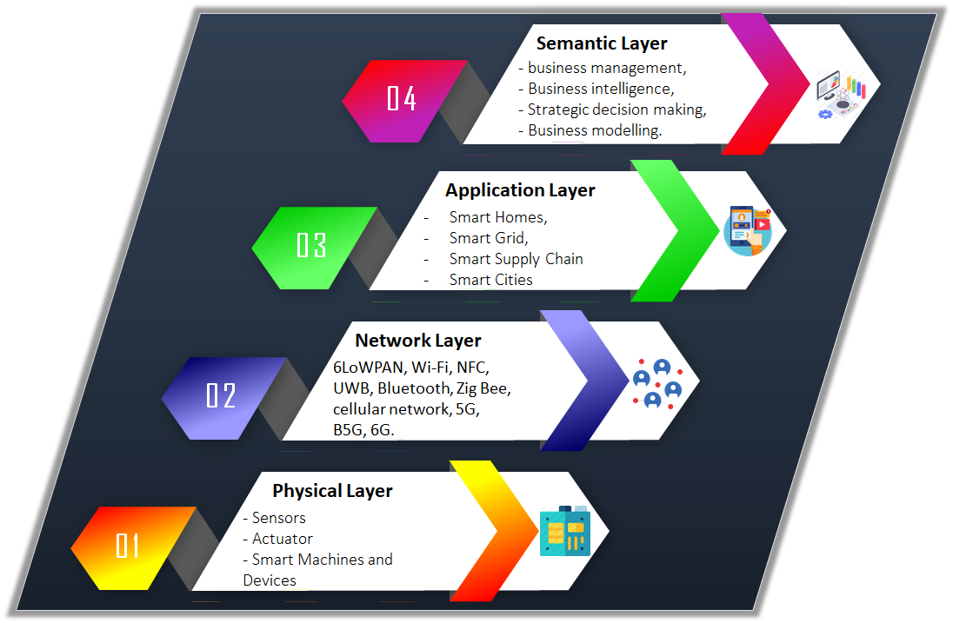
The Architecture of IoT system

Slide 4
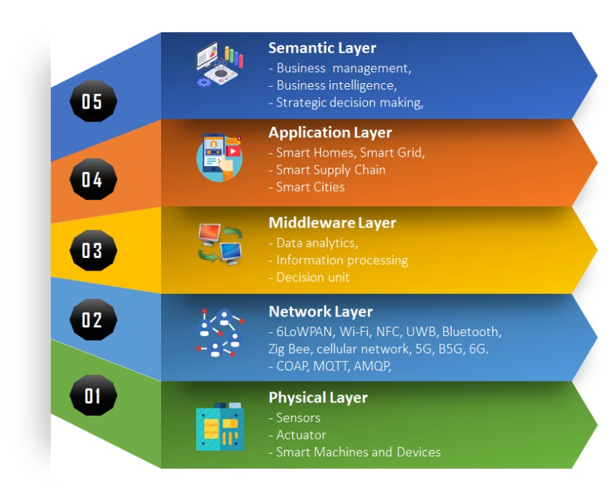
The Architecture of IoT system

Slide 5
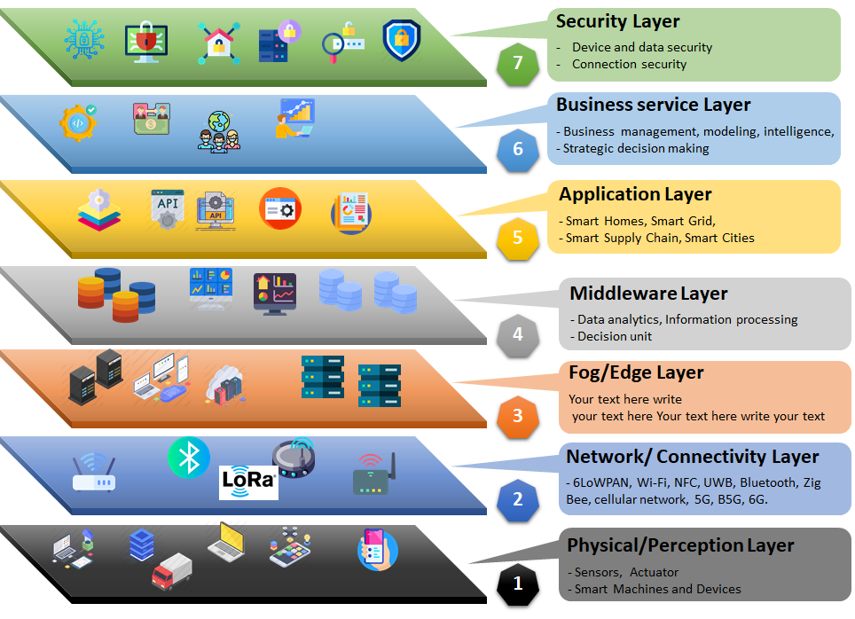
The Architecture of IoT system

Slide 6
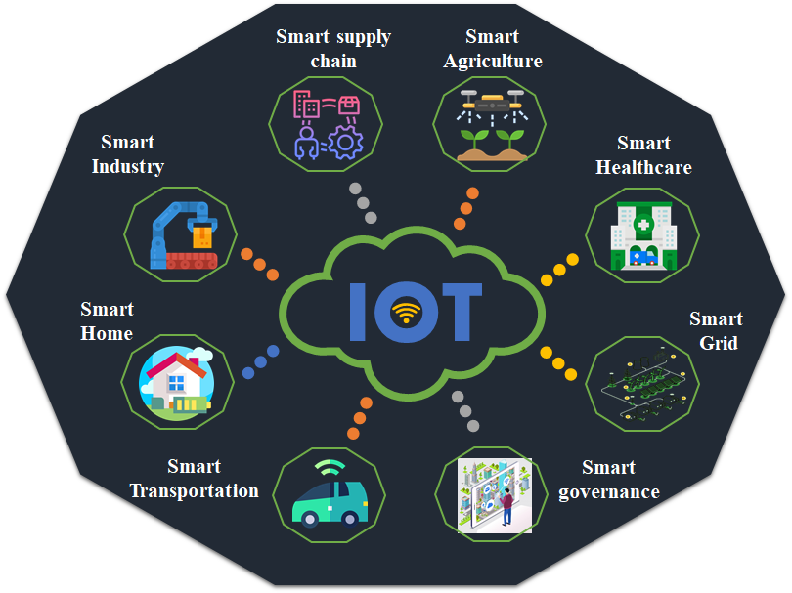
IoT Application

Slide 7
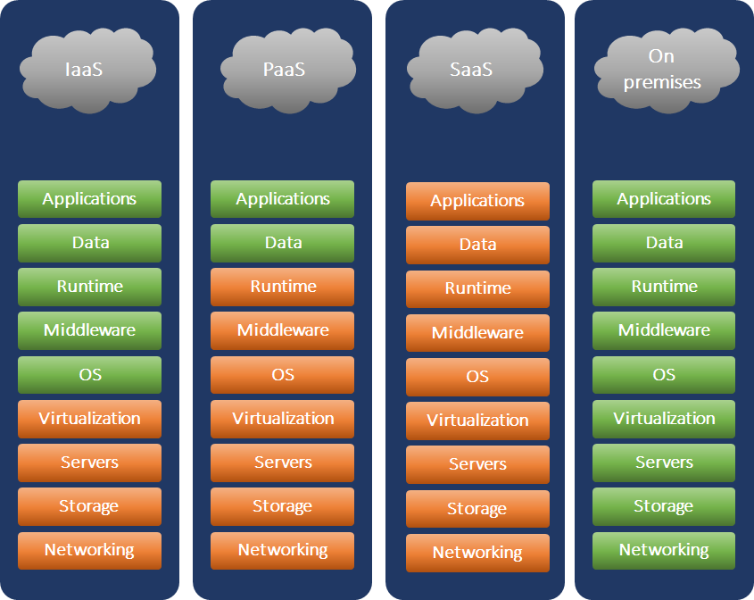
The Cloud Computing Based IoT system

Slide 8
The Fog Computing Based IoT system
A system-level horizontal architecture that distributes resources and services of computing, storage, control, and networking anywhere along the continuum from cloud to Thing.
fog computing considered as a modern computing model that transfers responsibilities from the cloud servers/datacenters to a lighter set of servers geographically close to network edges that collectively constitute a fog layer to be deployed, which consists of some servers deployed between the cloud backend and local IoT devices.

Slide 9
The Edge Computing Based IoT system
The fundamental concept behind edge computing is to transfer some demands and responsibilities from the core network to the access network, reaching the effective consumption of storage, computing, and communication capabilities.
This thought profoundly combines the conventional cellular network with the Internet facility, seeking to lessen the end-to-end latency of provision of mobile service .

Slide 10
Cloud vs fog vs edge
Features | Cloud Computing | Fog Computing | Edge Computing
Network Access | WLAN | Mostly LAN | LAN/WLAN
Mobility Support | Low | Low | High
Scalability of Servers | Very low | Distributed and low | Low or very low, depending on layers
Computing Power Location | Centralized | Distributed | Widely distributed
Reliability |  | High | Low
Deployment cost | Very High | Very Low | Low
Maintenance | Cloud Experts | Experts of enterprise | Expert, engineers, and employees of enterprise
Standardization | Yes | Yes | No
Operation Mode | Standalone | Standalone/ edge-cloud cooperation | Fog-cloud cooperation
Service Coverage | Global | Local | Local
Service Coverage | High | Low | Low
Virtualization | VM & containers | VM & containers | VM & containers
Constitutive Elements | IoT devices, cloud servers | IoT devices, edge servers, cloud servers | IoT devices, fog nodes, cloud servers

